Slide 1

2019 Website Update

Slide 2
Overview
Requirements
Purpose
Target Audience

Slide 3
Requirements
A website that will appeal to the western markets.
Simple, clutter-free design
An effective way to display company solutions, news and cases.
An efficient way to update, insert and modify new solutions, news and cases.
A section on key corporate latest news

Slide 4
Purpose
The company website currently representing Systemweb was made and continuously used without replacement for 4+ years. The website was developed mainly using pure HTML framework and conformed to the 90’s themes and layout. Any information updates or edits that were to take place would require excessive modification to the source code and image assets.
This website update provides a solution to the above mentioned problems by providing a mix of server-side and client-side rendering. Image assets and corporate contents are stored in a user-friendly external API which can easily insert, modify or remove contents without interaction with the original source code. The website is easy to maintain and tailored to the newer generation of web design.

Slide 5
Target Audience
3 DEMOGRAPHIC ARCHETYPES
New potential clients browsing through the surface of the website
Current clients looking for information on their current product
Old or on-going clients looking for product refresh

Slide 6
Structure
WordPress – Content management
GraphQL – Content querying

Slide 7

WordPress
WordPress is an online, open source website creation tool that can be used for blogging and website content management.
A website’s content can take many forms, including blog posts, information pages, landing pages, galleries, and product displays. All these and more can be set up and managed on a WordPress website builder site.

Slide 8
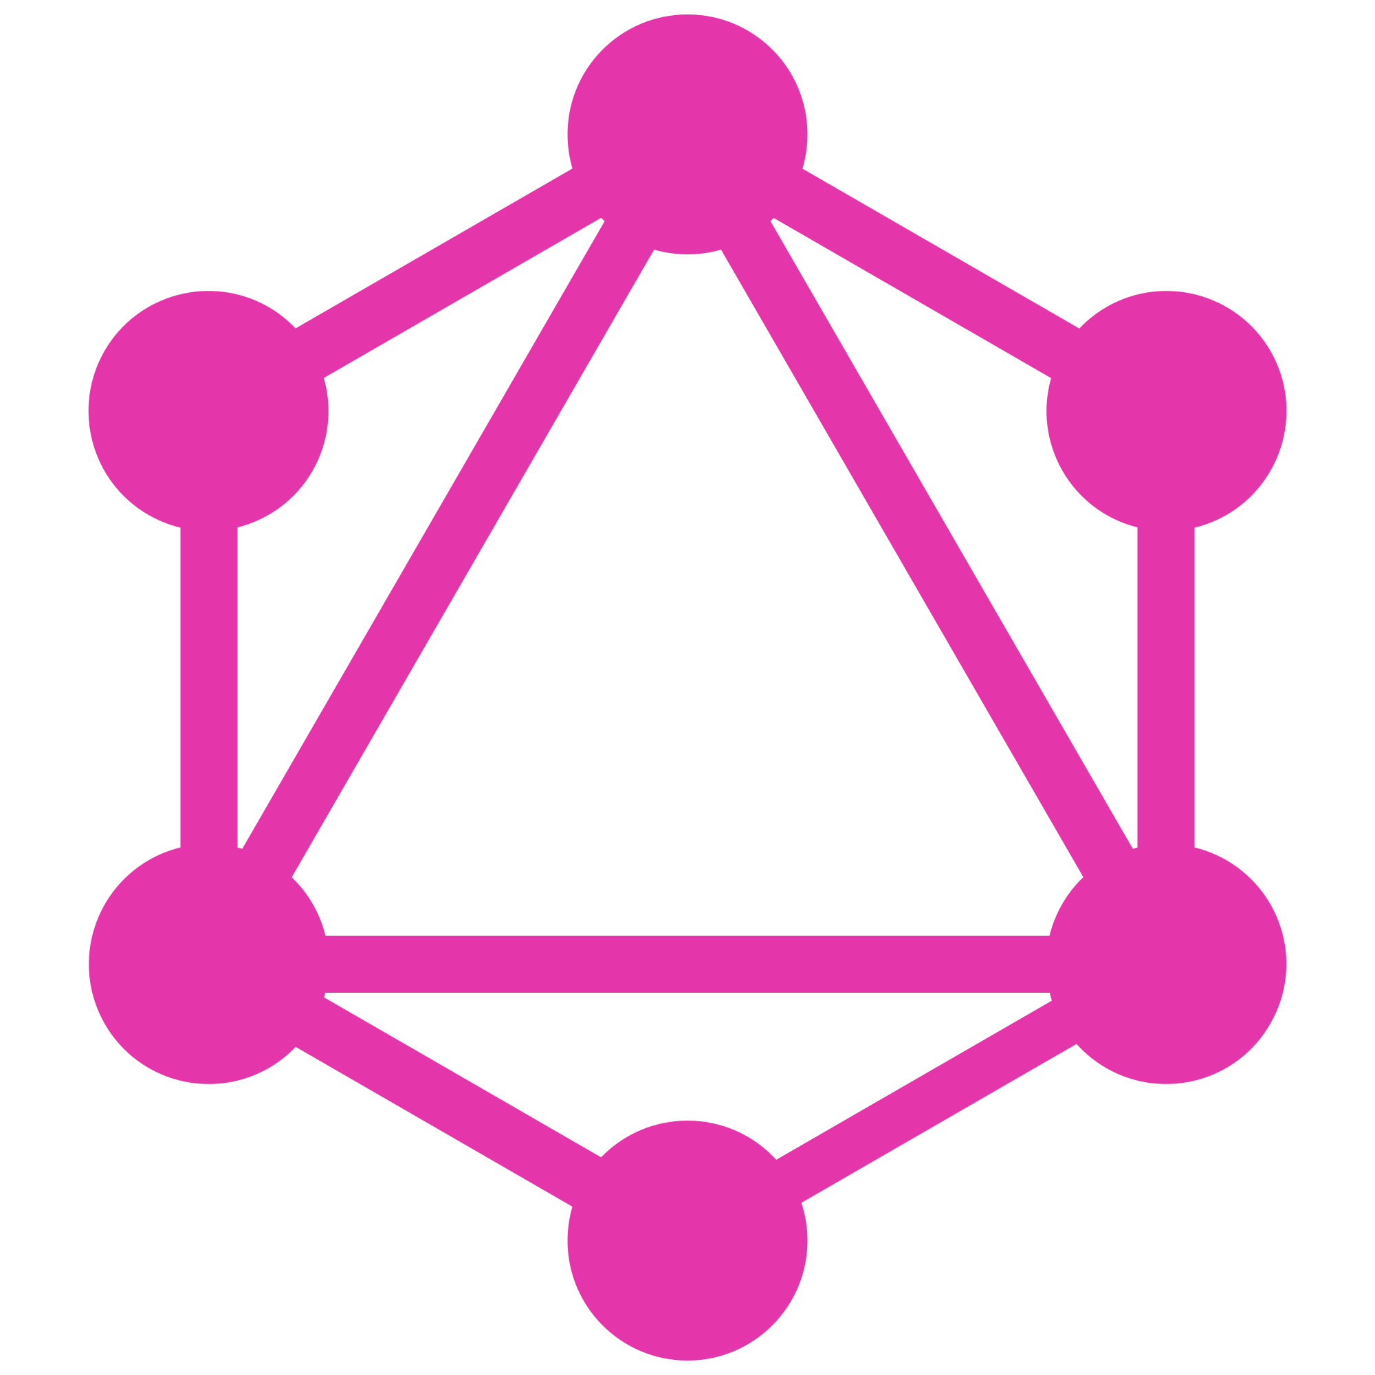
GraphQL
GraphQL is a query language for APIs and a runtime for fulfilling those queries with your existing data.
Send a query request to your API and returns the filtered data.

Slide 9
Integration
2
1
3
1. Content feed
2. Query
3. Results
New contents can be inserted, modified and removed in WordPress. The contents are then scraped by GraphQL in preparation to be queried.
Queries are pre-made and developed in the source code and user interactions can trigger a query to be sent.
The contents are filtered in GraphQL and the results are sent back to website.

Slide 10
Design
Home
Solutions / Cases / News
Contact Us
Search

Slide 11

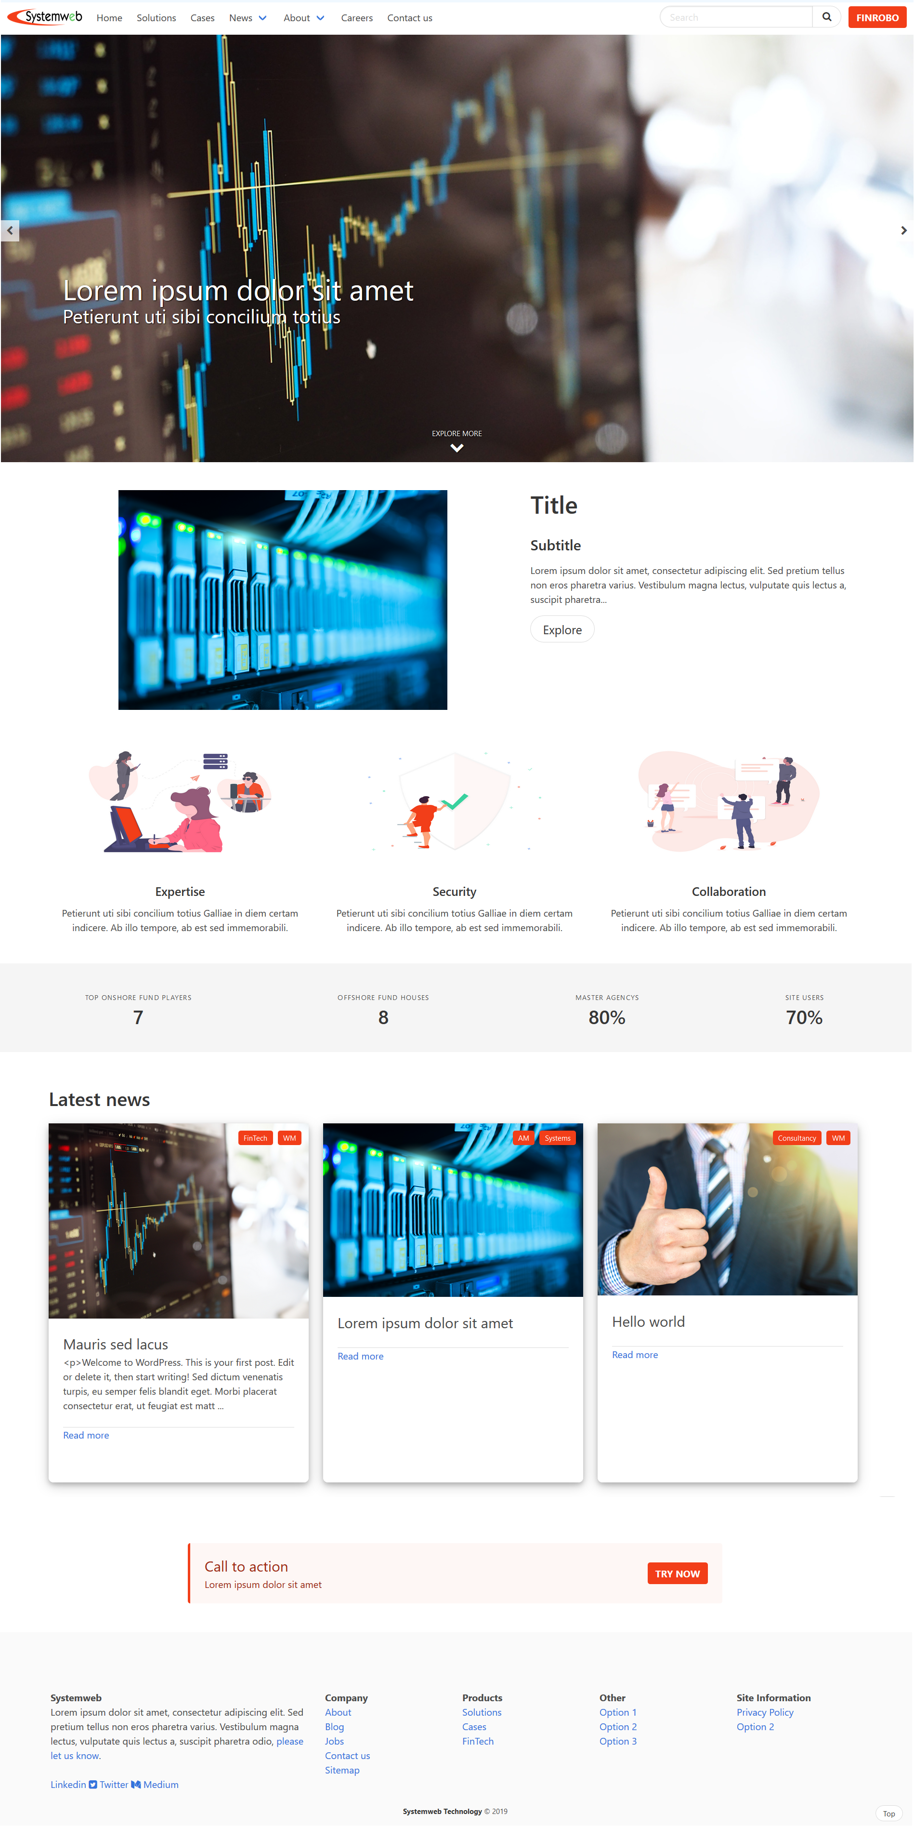


Home
Spans across ~4 screens, scrolling vertically.
Landing page shows a full screen carousel that can feature contents.
Clicking on “EXPLORE MORE” brings you to the current featured product.
Below that shows company information and statistics.
The last full screen content displays 3 latest news.
Finishes up with a site footer.

Slide 12
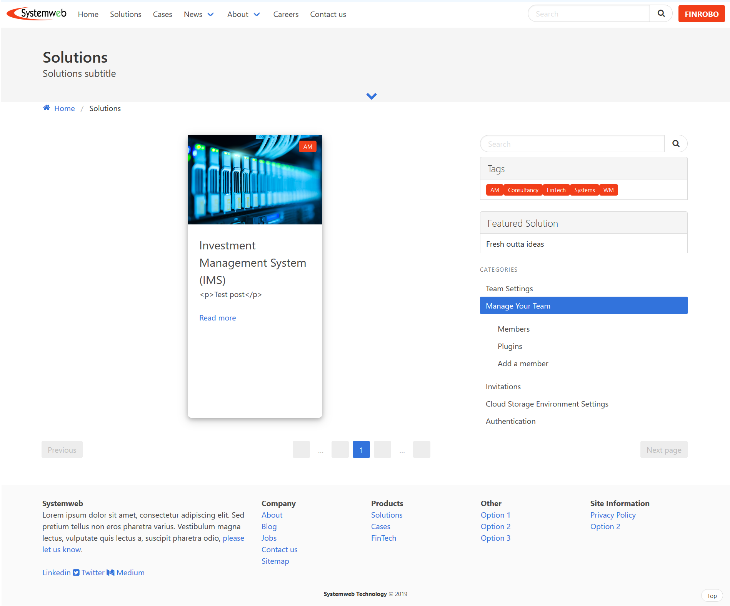
Solutions / News / Cases
Spans across ~2 screens.
The top banner displays the webpage title.
Clicking on the down arrow brings you to the content feed.
Content feed displays up to 3 information cards which can be run-time filtered through the search bar on the right hand side, or by the category tags.
Clicking on the pagination system down below to scroll through the list of information cards.
Finishes up with a site footer.

Slide 13
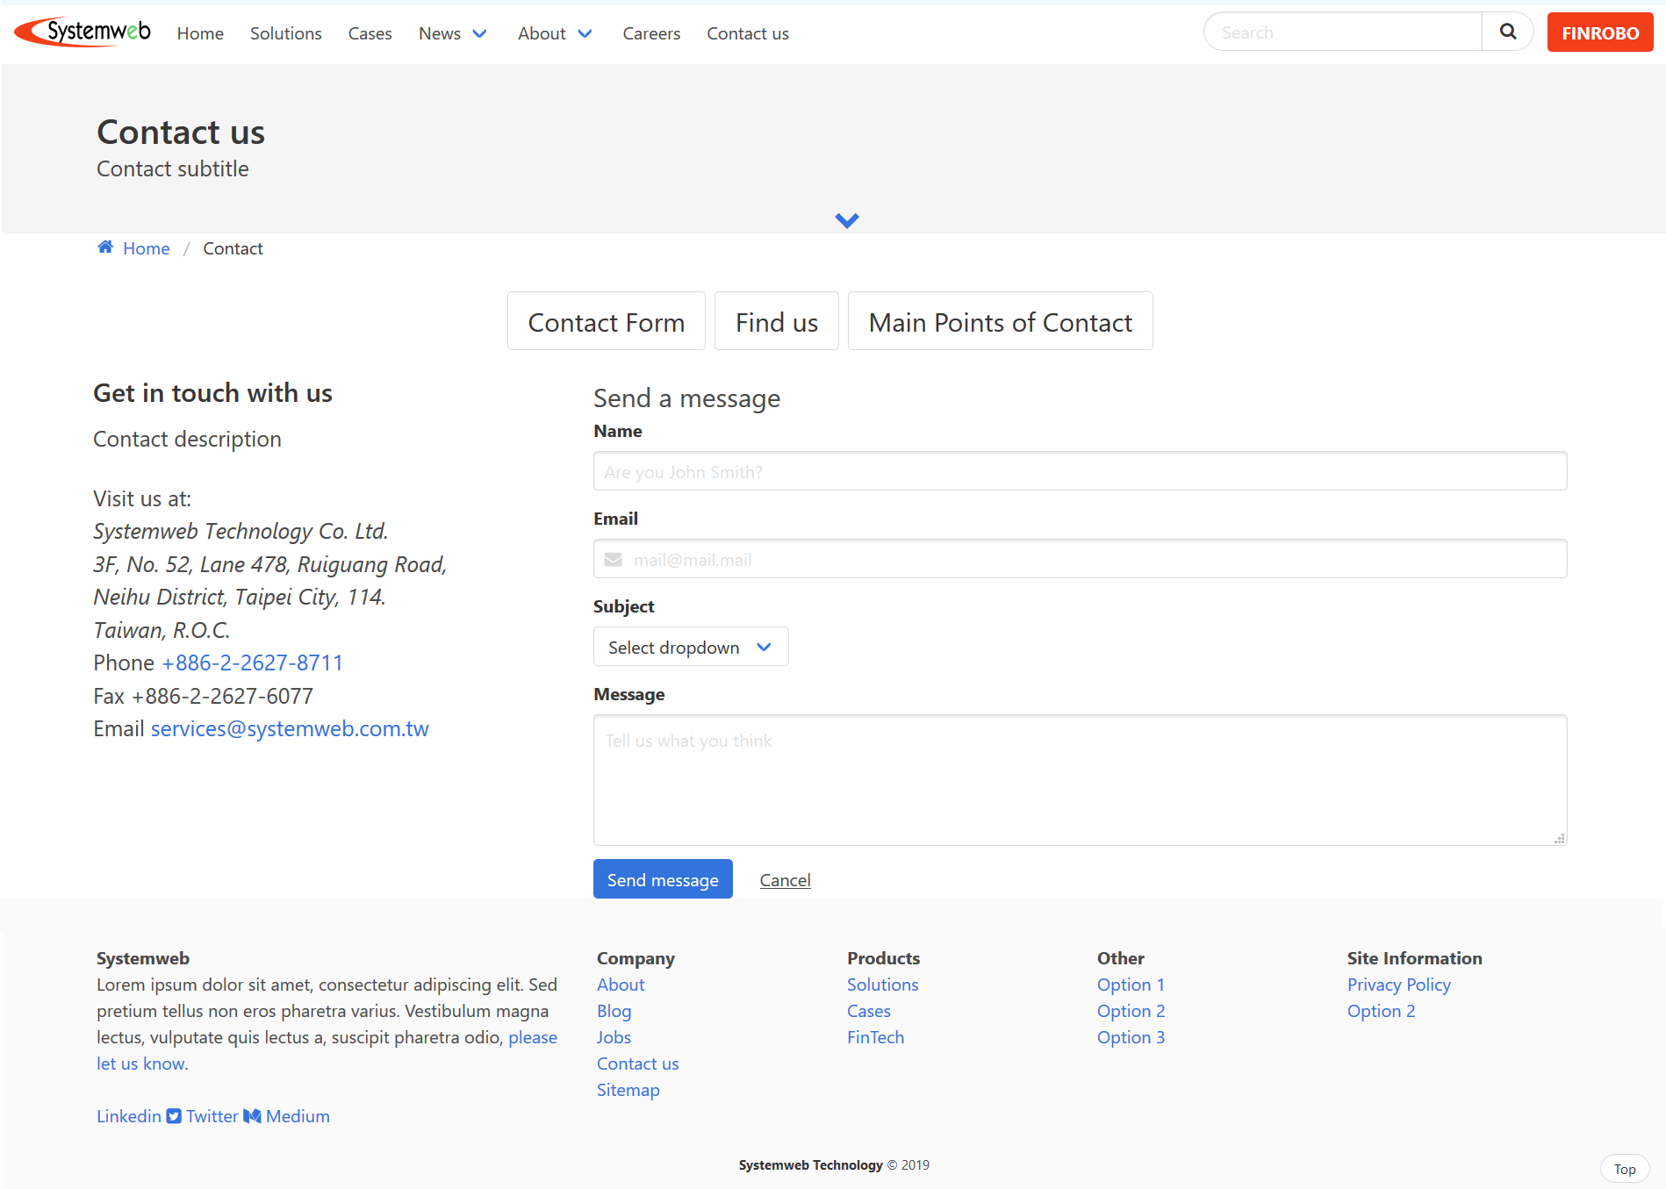
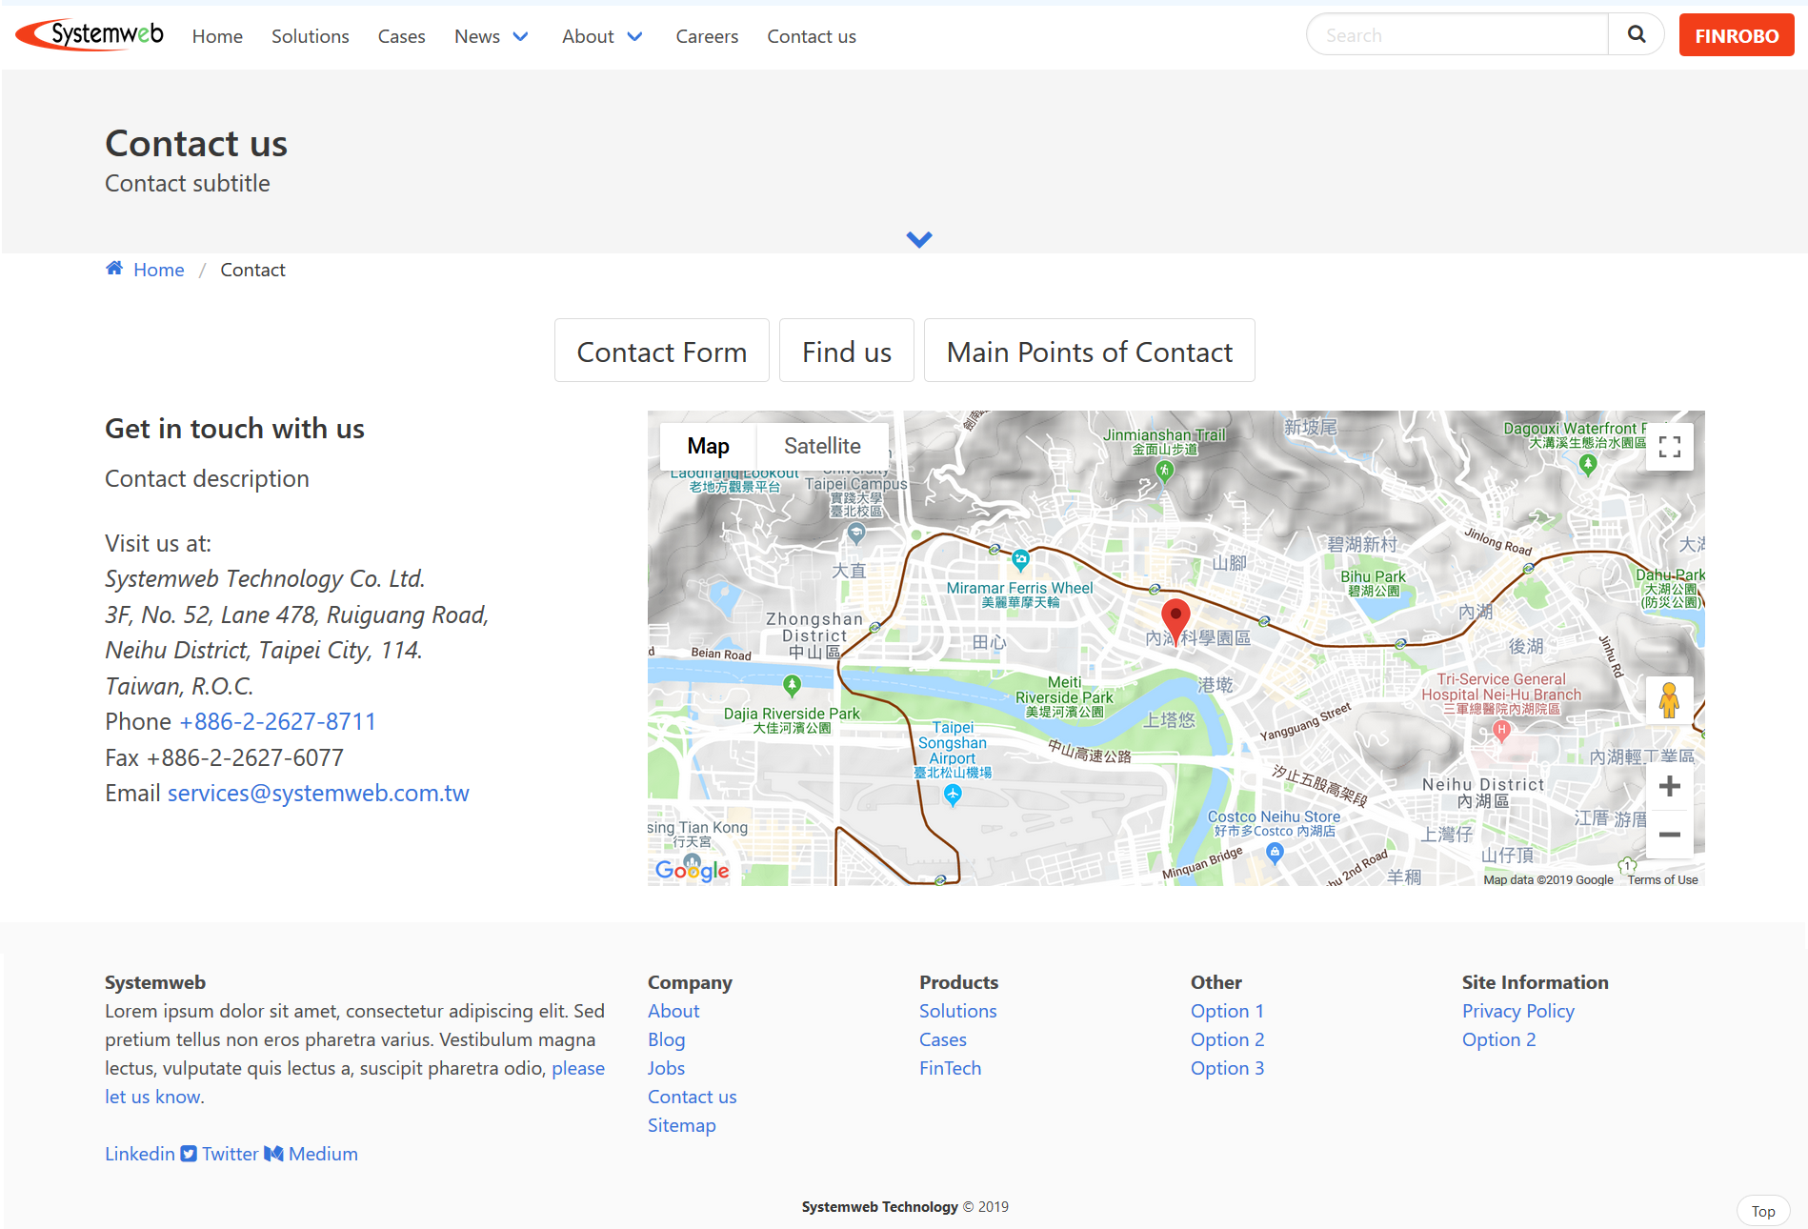
Contact Us
Figure 1
Spans across ~2 screens.
The top banner displays the webpage title.
Clicking on the down arrow brings you to the content feed.
Content displays figure 1 on default and also when “Contact Form” is clicked on.
Content displays figure 2 when “Find us” is clicked on.
Finishes up with a site footer.
Figure 2

Slide 14
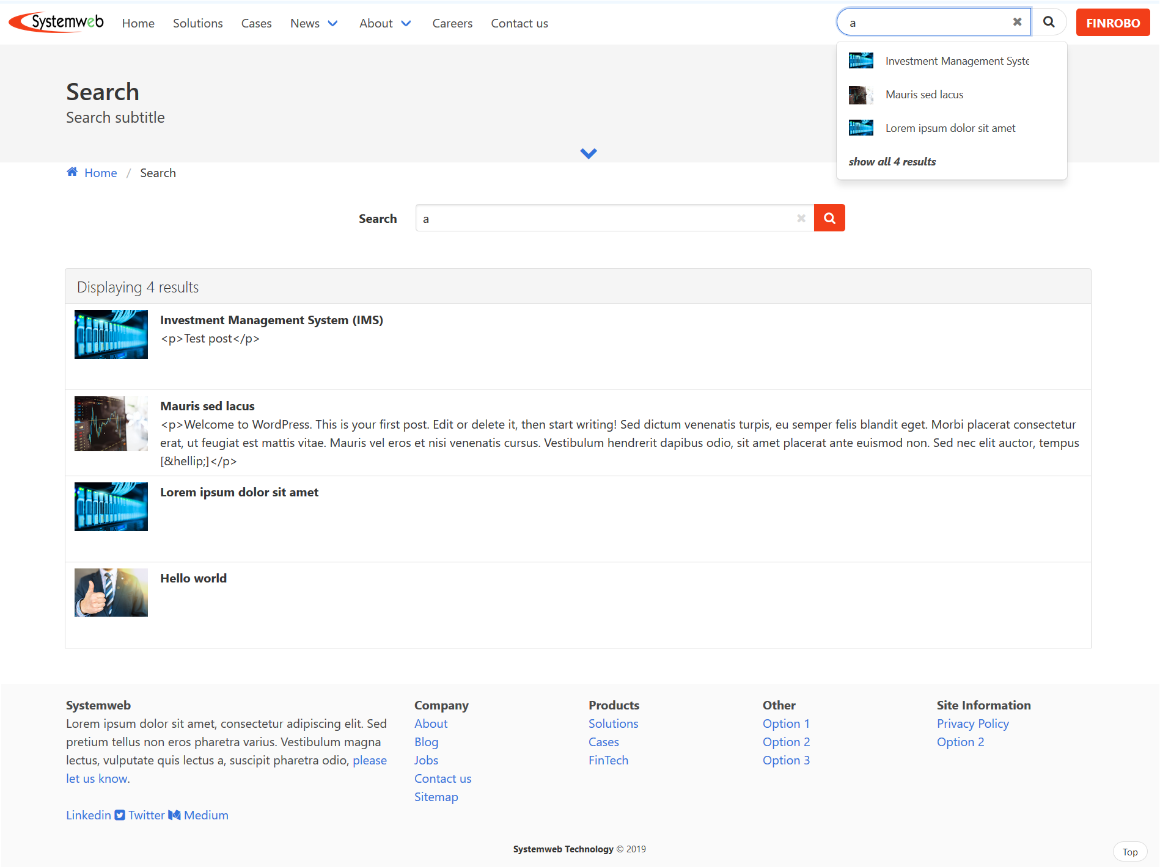
Search
Spans across > 1 screen.
The top banner displays the webpage title.
Clicking on the down arrow brings you to the content feed.
Page can be accessed by clicking on the magnifying button in the navigation bar.
User query is used to filter for results which displays as a drop down under the navigation search bar, or as a list on the Search page.
Finishes up with a site footer.

